Slide 1
Hair Rendering in Tomb Raider Stephan Hodes, AMD Wolfgang Engel, Confetti
Notes:
Wolfgang Engel, CEO of Confetti
Stephan Hodes, Developer Relations Engineer at AMD

Slide 2
Confetti
Think-Tank for game and movie related industries
Middleware packages
Global Illumination – Aura
Skydome system – Ephemeris
Post-Processing Pipeline - PixelPuzzle
Clients: INTEL, Qualcomm, AMD, many game developers (“Engine Tuner”)
Provides software solutions for games, movies and tools for GPU manufacturers
http://www.conffx.com

Slide 3
Overview
Motivation/History
Hair Authoring
Simulation
Rendering
Geometry Expansion
Anti-Aliasing
Lighting/Shadows
Per-Pixel linked list Usage
Blend & Sort
Performance Numbers

Slide 4
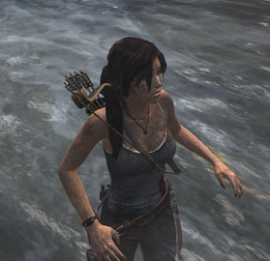
Motivation/History
Crystal Dynamics wanted “something special”
Unhappy with current state of Lara’s hair
Great opportunity to make the character stand out

Slide 5
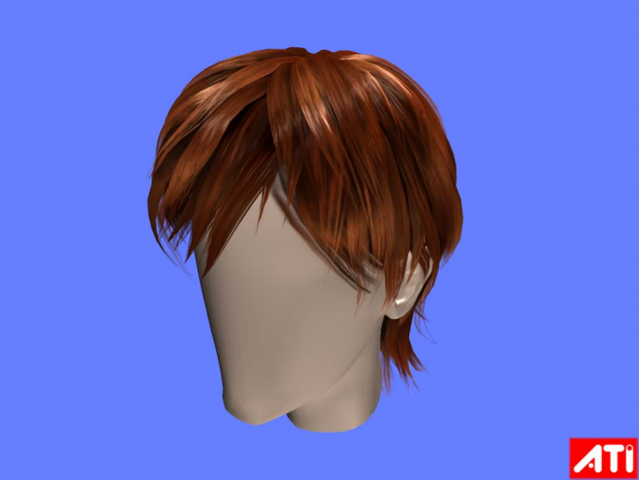
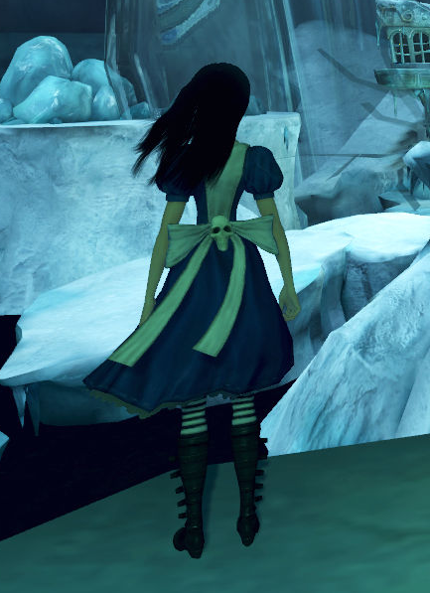
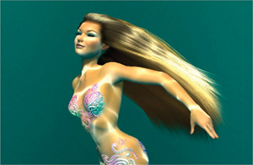
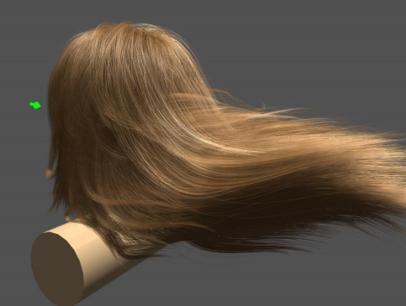
Motivation/History
Hair in rendering over time
ATI Ruby Hair (2004)
Nalu demo (2004)
Sarah Tariq (2008)
Alice Madness Returns (2011)
Agni’s Philosophy (2012)

Slide 6
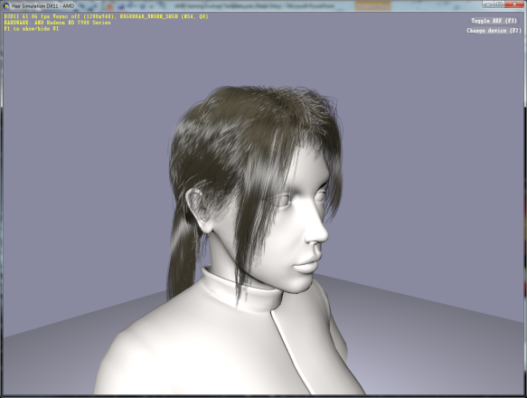
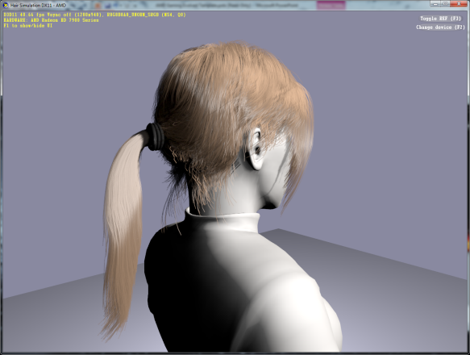
Motivation/History
AMD presented TressFX sample to Crystal Dynamics
Character model seemed somewhat familiar to them ☺
Based on “A Framework for Rendering Complex Scattering Effects on Hair“ [Yu et. All]
Notes:
Paper by AMD Research and University of Delaware

Slide 7
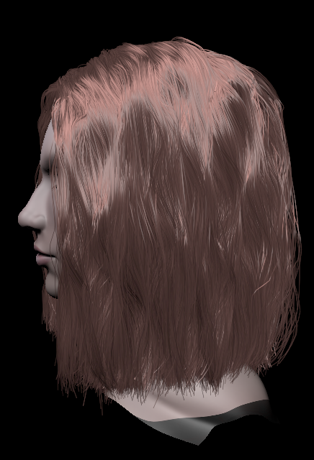
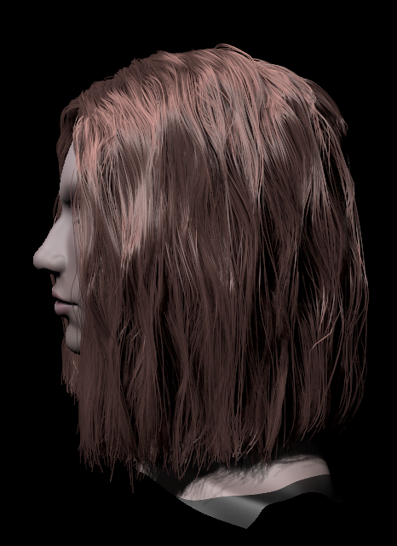
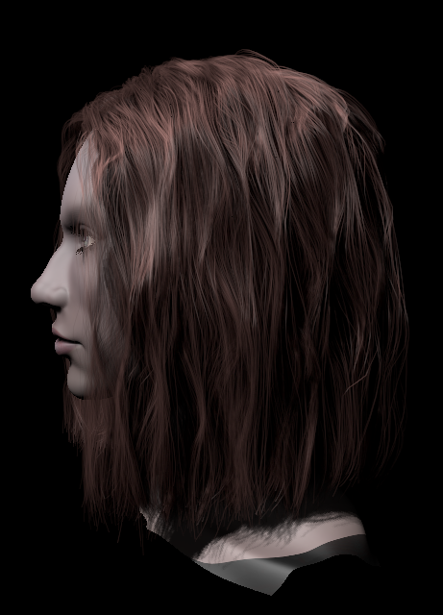
What is TressFX?
AMD technology for high-quality hair rendering
What goes into good hair?
Each hair strand simulated
Volumetric self shadowing
Transparency
Anti-aliasing
Anti-Aliasing
+ Volume Shadows
+ Transparency

Slide 8
What is TressFX?
Thousands of hair strands individually simulated and rendered on the GPU
DirectCompute physics simulation
Shader Model 5.0 pixel shader using compute capabilities for rendering
Sample code available from AMD
Contact your Alliance Manager or ISV Engineer
Or drop me an eMail ☺

Slide 9
Integration
Team effort involving multiple teams
Square Enix
Crystal Dynamics
Nixxes
AMD
Confetti
Confetti worked on integration, optimization and content pipeline
Iteration on optimizations throughout the project by all teams
Project duration ~6 months
SDK sample continuously updated to reflect most changes

Slide 10
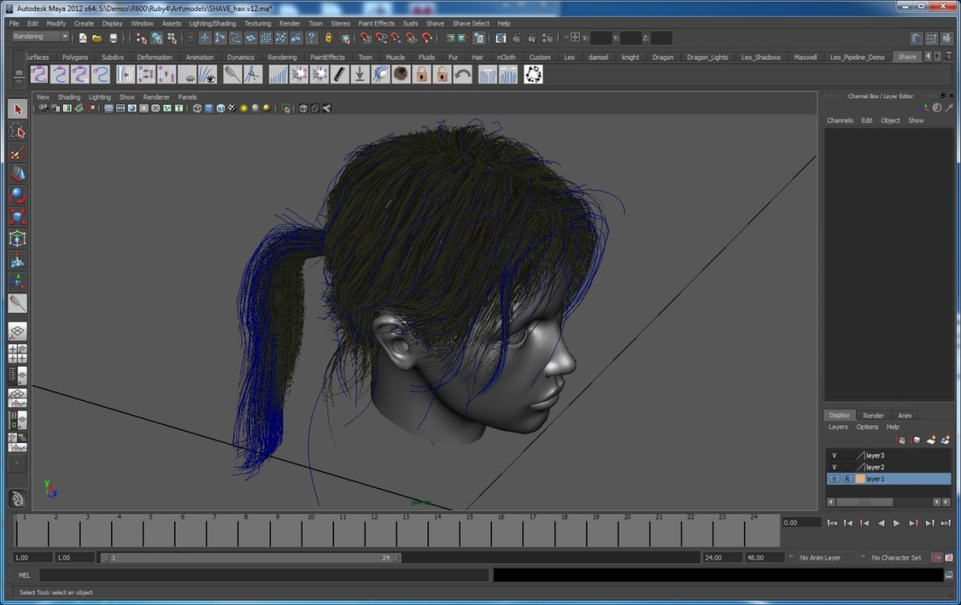
Hair Authoring
Shave and a Haircut
Maya plugin
Widely used film tool for hair
Custom exporter
http://www.joealter.com/
Can also export hair as splines directly

Slide 11
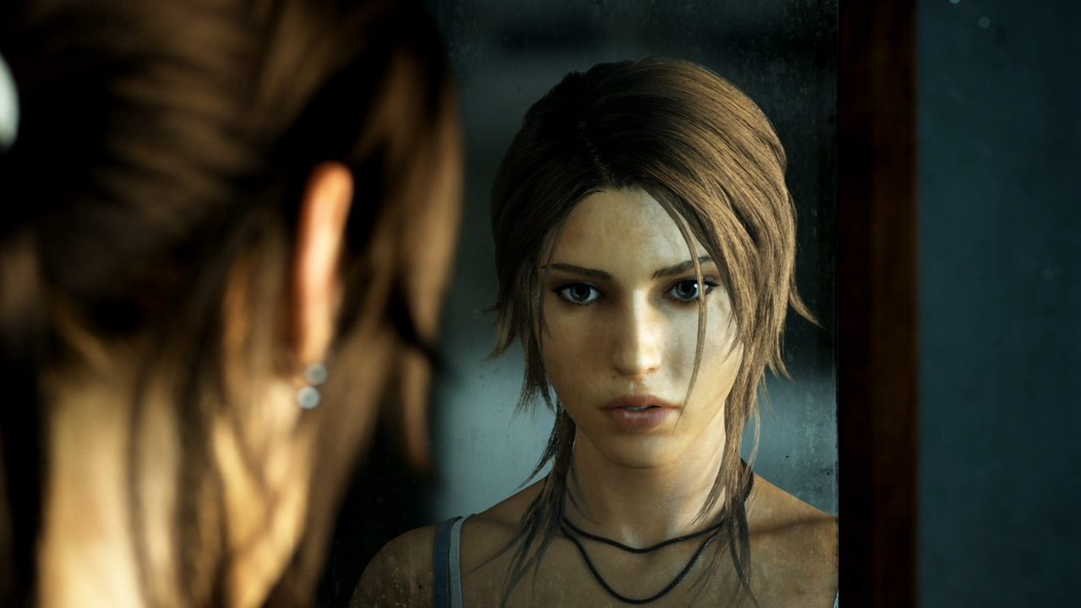
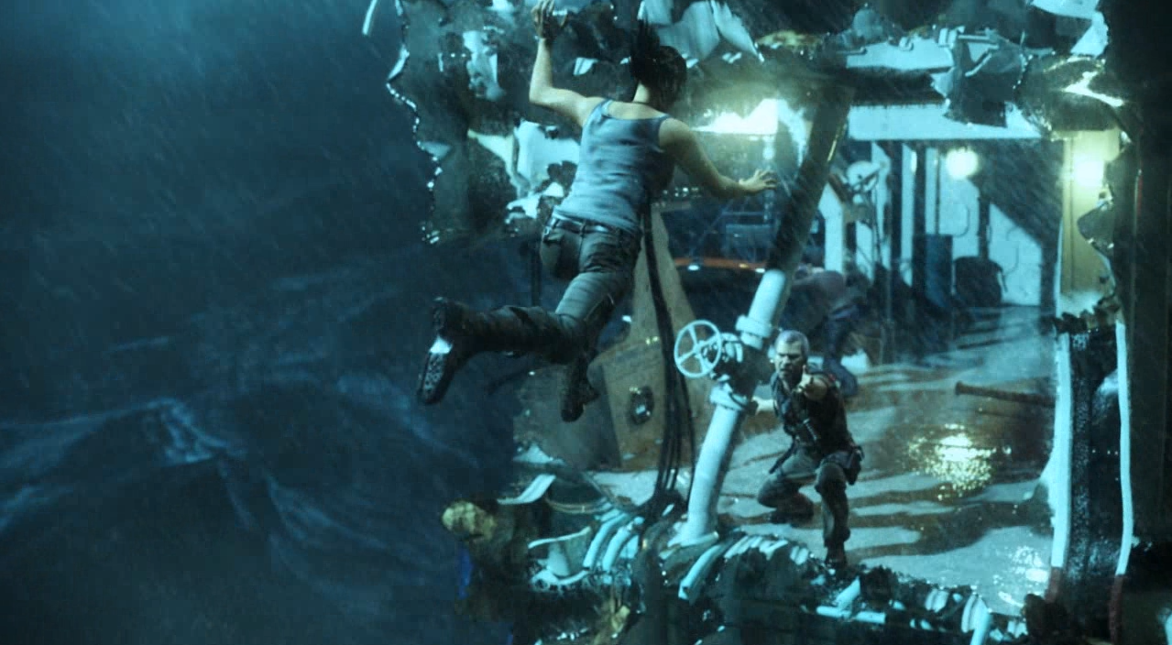
Hair Authoring
Square Enix has its own movie team (called Visual Works)
Crystal Dynamics decided to start with Tomb Raider trailer asset
Saved a lot of time since hair was already styled and ready to use
Had to add more hairs for coverage

Slide 12
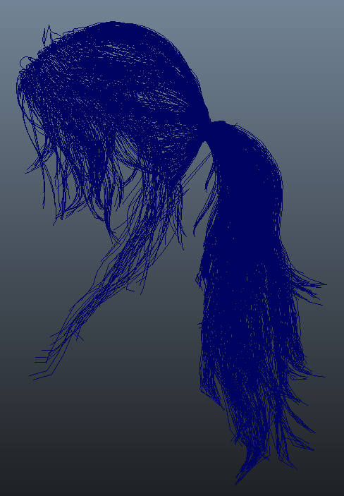
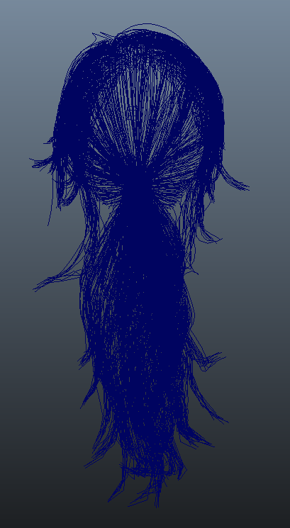
Hair Authoring
Visual Works hair
4,737 guide hairs used for render

Slide 13
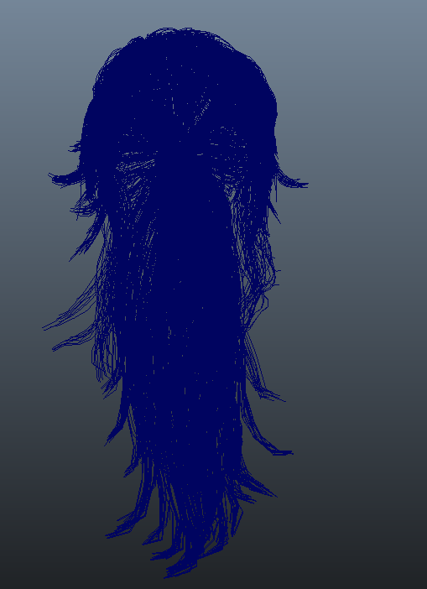
Hair Authoring
Crystal Dynamics hair
7,014 source splines
Duplicate source splines for coverage with offset
Final count is ~21,042 splines with 16 verts
TressFX Demo was ~20,000 splines and variable (1-32) number of vertices per spline
Notes:
On the average there are over one hundred thousand strands of hair on a young adult.
blondes average about 140,000 strands
brunettes average 108,000
redheads average 90,000

Slide 14
Hair Authoring
Splines organized together into primitive groups
4 groups (bangs, cap, fringe, ponytail)
Each spline broken down to 16 vertices
Positions
Tangents
Local/Global quaternions (for shape matching)
Resting lengths (distance between strand verts)
Thickness
Treat spline data like any other “model”
All spline vertices are written into single buffer

Slide 15
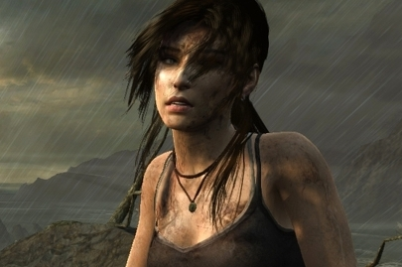
Simulation
What does hair look like when it moves?
How does a ponytail behave when running?
Jumping?
Rolling?
Windy conditions?
Found a muse early on
Michelle Jenneke
Notes:
Michelle "Shelly" Jenneke (born 23 June 1993) is an Australian hurdler, received worldwide media attention in 2012 for her pre-race warm-up, which involved dancing.
A lot of video material available
Erratic movement
Pony tail

Slide 16
Simulation
Physically based simulation
Responds to natural gravity
Collision detection with head and body
Support wind and other forces in an artist-friendly way
Programmatic control over attributes
Constraints maintain hair style
Can tweak for different results
Notes:
Make the hair look wet when passing under water
Can tweak for different results: hair weight, hair rigidness etc.

Slide 17
Simulation
Initialization is performed on CPU only once
Preferably offline
Update is performed at each frame on GPU
All data resides on the GPU
Update of one strand is a serial process but independent to other strands.
So we can update multiple strands in parallel

Slide 18
Simulation
Each strand consists of 15 line segments connected through joints
Each joint has parent-child relationships to its connected joints – Forward Kinematics
With local transforms in chain structure, we can get a global transforms
y_{i}
x_{i}
i
z_{i}
${{}_{ }^{w}T}_{i}^{}={{}_{ }^{w}T}_{0}^{}∙{{}_{ }^{0}T}_{1}^{}…∙$ ${{}_{ }^{i−2}T}_{i−1}^{}∙{{}_{ }^{i−1}T}_{i}^{}$
x_{i-1}
i-1
y_{w}
y_{i-1}
z_{i-1}
x_{w}
z_{w}
w

Slide 19
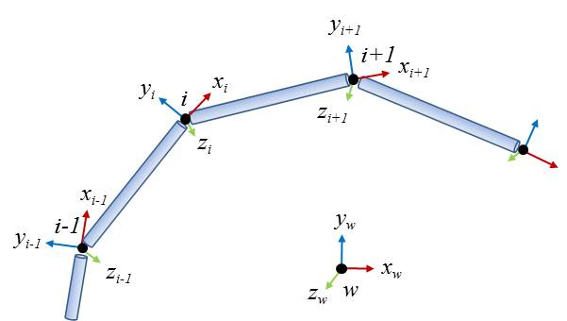
Simulation
After applying external forces global shape constraints are applied to each vertex to make them return to initial position
Local shape constraints make vertices return to initial local position w.r.t local frame
This maintains the hair style, e.g. curls
With both constraints, hair shapes can be maintained without tangling in weird shapes during fast moving gameplay

Slide 20
Simulation
Global Shape Constraints
The initial positions of particles serve as the global goal positions
The goal positions are rigid w.r.t character head transform.
Easy and cheap. Help maintain the global shape but lose the detailed simulation
initial goal position
current position
final position
Notes:
Global shape constraints are using the initial hair vertex positions as their goal positions.
The global goal position are eventually determined by considering character head transform but this transform is uniform and rigid across all hair vertices and is a given input.
Global shape constraints are easy and cheap. They help maintain the global shape even under extreme agitations.

Slide 21
Simulation
Local Shape Constraints
The goal positions are determined in the local coordinates
Local coordinates should be updated at each particles
initial goal position
current position
final position

Slide 22
Simulation
In Tomb Raider Simulation consisted of 5 shaders (A-E)
A: Gravity + Integration and Global Shape Matching
B: Local Shape Constraints
C: Wind application and length constraint enforcement
D: Extra length constraint for erratic movement
E: Capsule collision position constraints
Notes:
In high velocity situations B gets applied after D for the pony tail
Up to 12 capsules per group

Slide 23
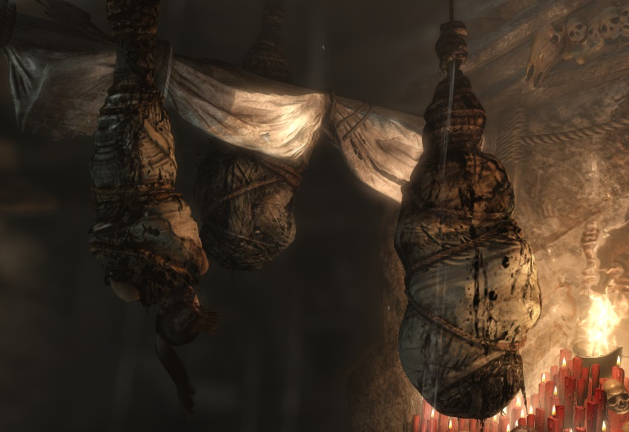
Simulation
Some situations require specially authored assets:
Wet Hair
Sac Swing
Weapon Aiming
Cinematics

Slide 24
Simulation
Use hair profiles to drive the simulation of each group
These allow us to set up parameters to define hair in different states (dry vs wet for example)
Profile data is blended together when changes are needed
i.e. when going from dry to wet or vice versa
Use a total of 7 simulation profiles
Dry, Mid Wet, Wet, Weapon Aiming, Upside Down,
Upside Down Sac Swing, Special Cine Clamp Down

Slide 25
Visualization
Overview
Geometry Expansion
Anti-Aliasing
Lighting
Shadows
Per-Pixel linked list Usage
Blend & Sort
Performance Numbers

Slide 26
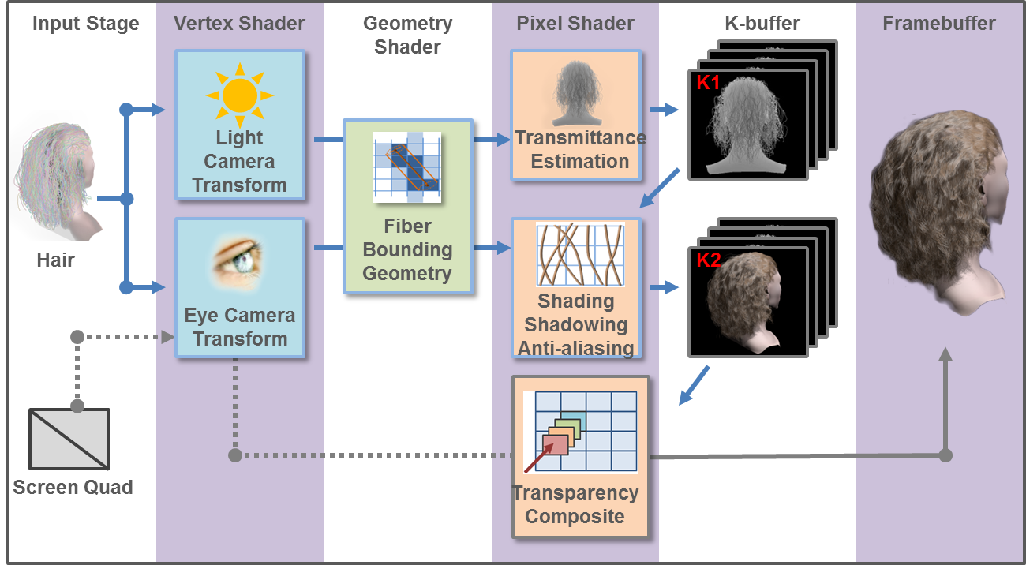
Overview
The original rendering pipeline stages from the paper [Yu et. All]

Slide 27
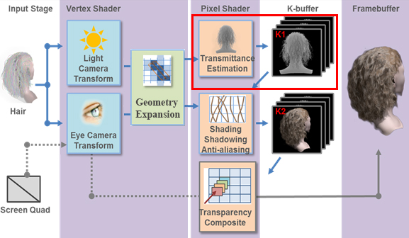
Overview
Rendering pipeline in Tomb Raider:

Slide 28
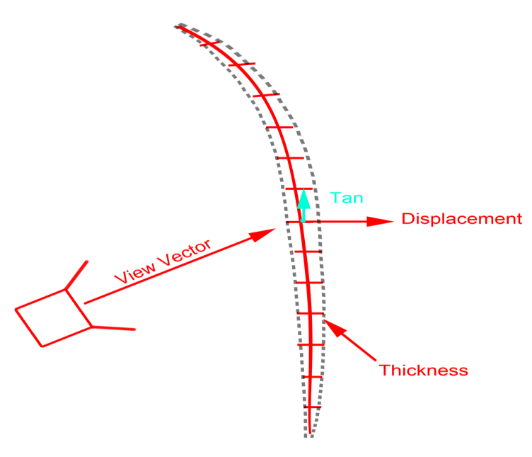
Geometry Expansion
Each hair segment is expanded into two triangles == quad
To get a direction vector perpendicular to the hair segment we take cross(tangent, viewVec)

Slide 29
Geometry Expansion
We construct the two triangles for each quad in world-space
Use the Vertex_ID value to create quads
2 triangles per quad
15 quads per strand (spline)
1
0
2
3
4

Slide 30
Geometry Expansion
In a second step the quad is projected into screen-space and expanded by pixel width (user defined value)
Ensures a strand covers at least a pixel width

Slide 31
Geometry Expansion
Draw call
Empty index and vertex buffer
Pull vertex data from Compute results
Use SV_VertexID to lookup vertex data

Slide 32
Geometry Expansion
What number to provide to the draw call?
Example
For example you have One hair strand with 16 vertices or 15 segments -> draw call consists of number of segments * 6 -> 90 vertices
In the “cooker” we count the number of segments and take the number of segments * 6 -> this is what is provided to the draw call

Slide 33
Geometry Expansion
Final output consists of:
Position
Tangent
Left hair edge (screen-space) for AA (later in code p0)
Right hair edge (screen-space) for AA (later in code p1)
Texture coordinates

Slide 34
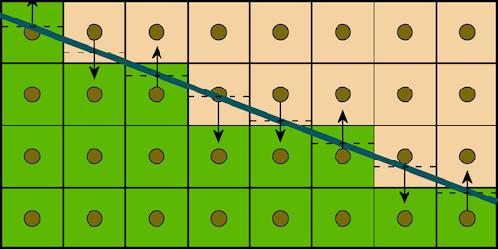
Anti-aliasing Computation
Calculating the pixel distance to the closest hair edge similar to GPAA [Persson]

Slide 35
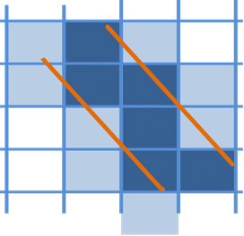
Anti-aliasing Computation
Use the interpolated hair screen space edges coming from the vertex shader and the screen space position of the pixels

Slide 36
Anti-aliasing Computation
The distance from the edge to the pixel center is considered the alpha value for alpha blending
Higher value -> less transparent
Lower value -> more transparent
Inside hair strand -> 1.0
Outside hair strand < 1.0
Then alpha blending is used to blend the hair into the frame buffer

Slide 37
Anti-aliasing Computation
// p0 / p1 are the interpolated values on the edge of the hair, coming from
// the vertex shader
p0dist = length(p0 - pixelLoc);
p1dist = length(p1 - pixelLoc);
hairWidth = length(p0 - p1);
// figure out if we are inside or outside the hair
// if we are outside the hair we want to scale towards zero, if we are
// inside, we want to scale towards 1
// will be 1.f if pixel outside hair, 0.f if pixel inside hair
outside = any( float2(step(hairWidth, p0dist), step(hairWidth,p1dist)) );
sign = outside > 0.f ? -1.f : 1.f;
// signed distance (positive if inside hair, negative if outside hair)
relDist = sign * saturate( min(p0dist, p1dist) );
// returns coverage based on the relative distance
// 0, if completely outside hair edge
// 1, if completely inside hair edge
return (relDist + 1.f) * 0.5f;

Slide 38
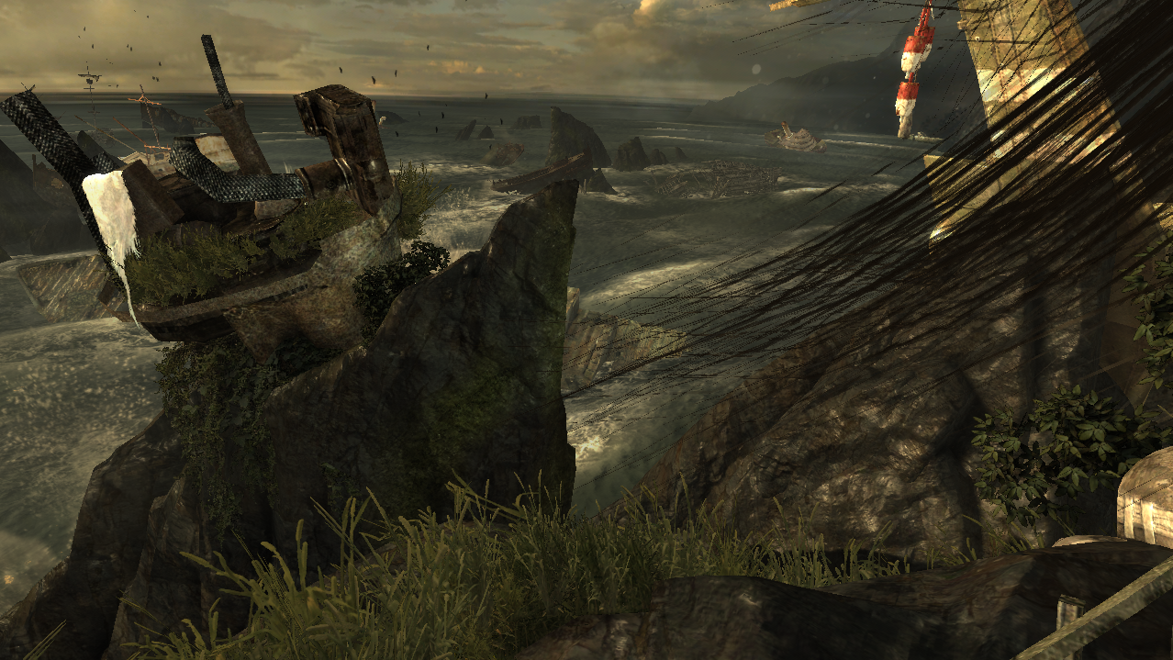
Anti-aliasing Computation

Slide 39
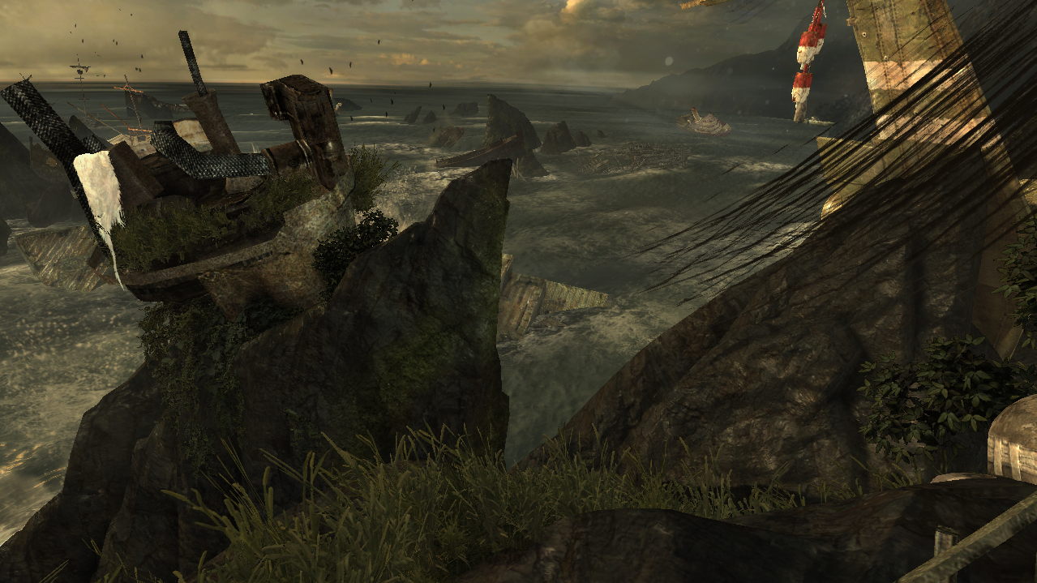
Anti-aliasing Computation

Slide 40
Lighting

Slide 41
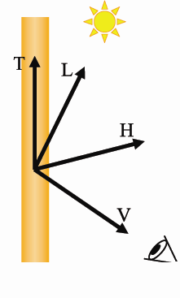
Lighting
Lighting of Hair uses the modified Kajiya & Kay model [Kajiya]
Hair strand == infinitely thin cylinder
Anistropic strand lighting model
Similar to standard Blinn- Phong: uses hair Tangent T instead of Normal

Slide 42
Lighting
This lighting model was modified by Marschner [Marschner] [Scheuermann]
Math is complex, we’re just trying to match these observations phenomenologically ☺

Slide 43
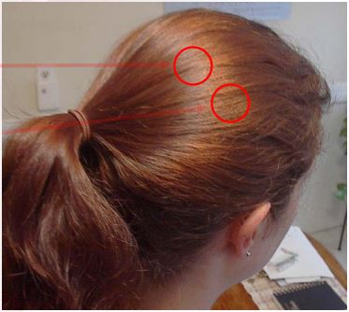
Lighting
Based on measurements of hair scattering properties
2 shifted tangents to get
Primary specular highlight shifted towards hair tip “light spec” – color of light
Secondary specular highlight shifted towards hair root “hair spec” – color of hair

Slide 44
Lighting
Lighting equation (ambient + diffuse + hair spec) * hair color + light spec
Use a diffuse texture for the hair -> gives different hair strands different color
Use hemispherical ambient lighting or irradiance coefficient depending on unit
Had 2 rendering profiles that described dry vs. wet hair

Slide 45
Shadows
Deep shadow maps is too expensive
Following the existing shadow map approach, the hair shadows were approximated
Render hair splines as lines to shadow maps
Do a deep shadow approximation when self-occluding hair
Compare the depth in the shadow map == the closest to the light with the depth of the hair strand that we are currently drawing
If the distance between the hair strand that is currently drawn and the hair strand that is the closest to the light is large, the shadow value is darker
Bottom hair receives darker shadow values
Top hairs receives brighter shadow values

Slide 46
Shadows
Each shadow term is stored in the per-pixel linked list combined with the lighting for each strand
After the per-pixel linked list is “resolved” the resulting value is written into the framebuffer
In case there is a tree shadow on top of hair, it will be dark from that shadow already

Slide 47
Shadows
Source code:
// lightSpaceLinearDepth – depth of the renderer hair pixel
// shadowLinearDepth – depth in the shadow map – only holds the closest to the light
float depthRange = max(0.f, lightSpaceLinearDepth - shadowLinearDepth);
// invFiberWidth – artist defined value what the width of the hair strands should be
float numFibers = depthRange * invFiberWidth;
if(depthRange > 1e-5) // 0.00001
numFibers += 1;
//
// stronger shadow term the deeper the fragment is within the hair
// g_FiberAlpha – artist defined value to control the strength of the shadow value
return pow(abs(1 - g_FiberAlpha), numFibers);

Slide 48
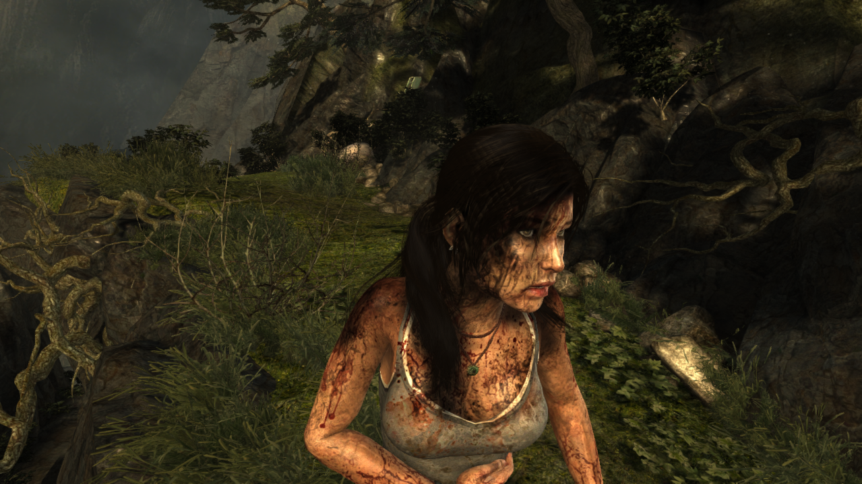
Naïve shadow map approach

Slide 49
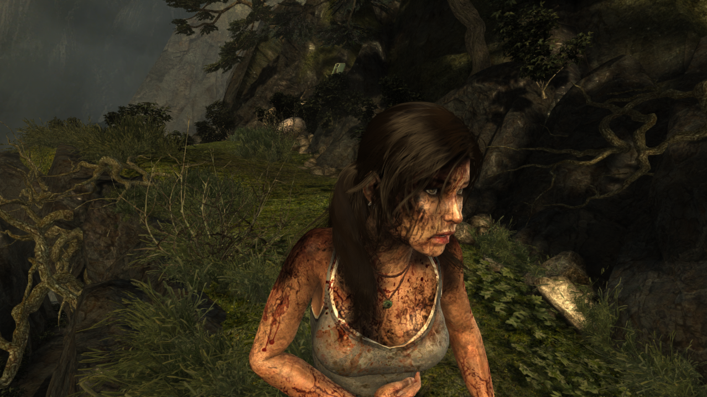
Approximated Deep Shadow Map

Slide 50
Per-Pixel Linked Lists
Based on “Real-Time Concurrent Linked List Construction on the GPU” [Yang]
Each element holds three packed uints
Fragment color (4 byte) (alpha in fourth channel)
Depth (4 byte)
+ link (4 byte)
Allocation is resolution * 12 bytes * 8
Works well 99% of the time
Can cause artifacts if hair takes up the entire screen
At 1080p this costs ~200 MB
Slightly higher in multi monitor setups (* 12)

Slide 51
Per-Pixel Linked Lists
Requires two buffers
Fragment and link buffer – holds elements
struct FragmentAndLinkBuffer_STRUCT
{
FramentData_STRUCT FragmentData;
uint uNext;
}
RWStructuredBuffer<FragmentAndLinkBuffer_STRUCT>FLBuffer;
A “Start Offset Buffer” (SOB) holds offsets

Slide 52
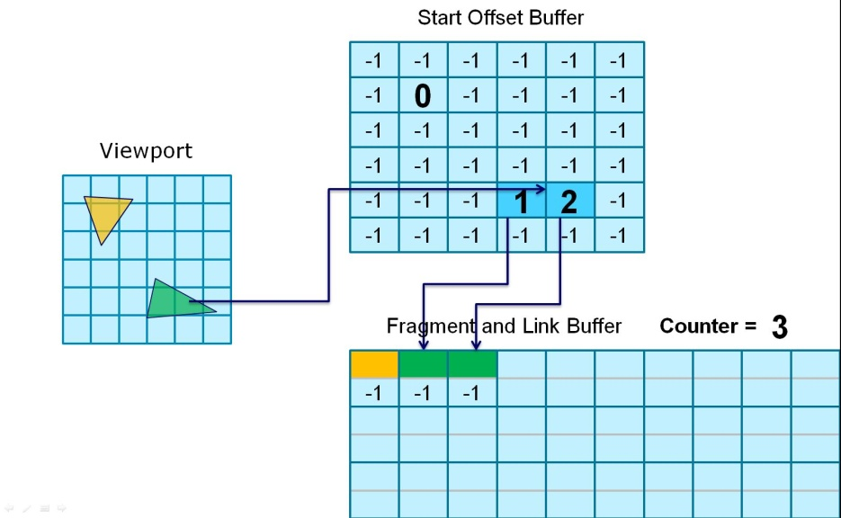
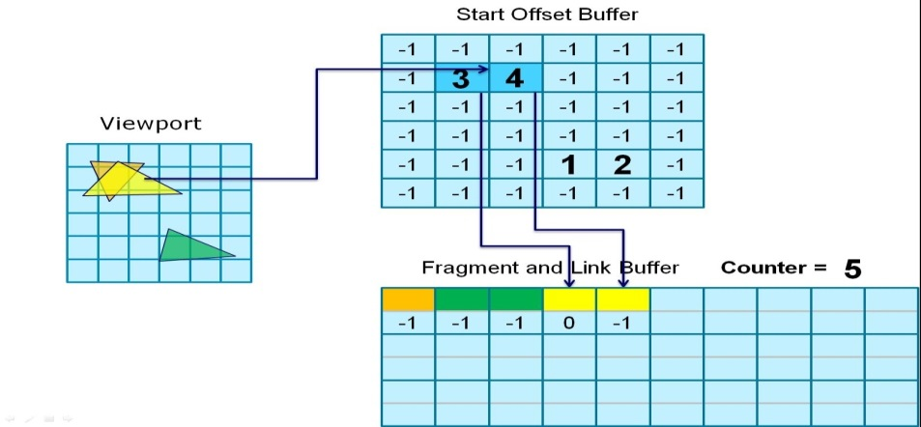
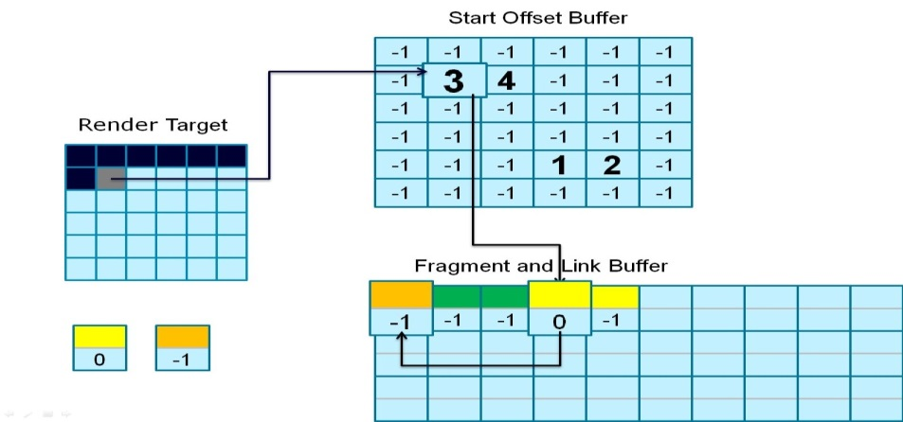
Per-Pixel Linked Lists

Slide 53
Per-Pixel Linked Lists
Traversing:
viewport / SOB same size
Look at the pixel in the SOB
then follow the uNext entry in FLB until it is -1

Slide 54
Sort & Blend
From the maximum 256 layers only the top 8 layers were sorted based on depth
The remaining layers were just blended out of order
Hair is stenciled out - so only the necessary pixels are touched

Slide 55
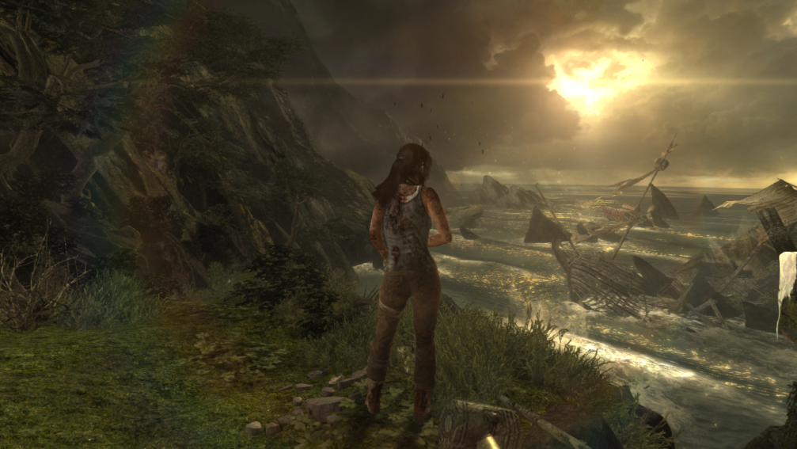
Performance Numbers
Pass | Number of draw calls | Time on Radeon HD 7970 (ms)
Regular Distance (Ocean Vista)
Compute | 23 | 0.9439
Shadow map render | 16 | 0.7963
Shading and AA | 4 | 1.9690
Sort/Apply/Fog | 1 | 1.0978
Total | 44 | 4.8070

Slide 56
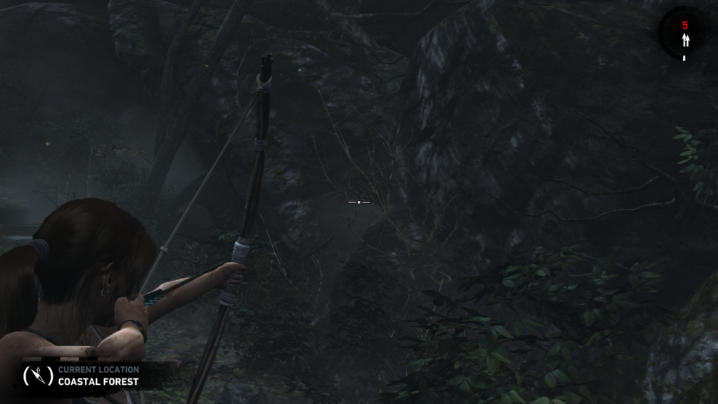
Performance Numbers
Pass | Number of draw calls | Time on Radeon HD 7970 (ms)
Weapon Drawn (AC Main)
Compute | 27 | 1.0307
Shadow map render | 4 | 0.2058
Shading and AA | 4 | 4.5677
Sort/Apply/Fog | 1 | 1.752.3
Total | 36 | 7.5559

Slide 57
Further Ideas
Re-structure list elements
Fragment color (3 byte)
Alpha (1 byte)
Additionally: occlusion – (1 byte)
Depth -> 2 byte
+ link (4 byte)
Re-organize shadow handling into shadow buffer and shadow collector

Slide 58
References
[Yang] Jason C. Yang, Justin Hensley, Holger Grün, Nicolas Thibieroz, “Real-Time Concurrent Linked List Construction on the GPU”, EGSR'10
[Kajiya] J. Kajiya, T. Kay, “Rendering fur with three dimensional textures”, in SIGGRAPH 89 conference proceedings, pp. 271 – 280, 1989
[Marschner] Stephen R. Marschner, Henrik Wann Jensen, Mike Cammarano, Steve Worley, and Pat Hanrahan, “Light Scattering from Human Hair Fibers”, in SIGGRAPH 2003 proceedings.
[Persson] Emil Persson, “Geometric Anti-Aliasing Methods”, GPU Pro 3, CRC Press
[Scheuermann] Thorsten Scheuermann, “Hair Rendering and Shading”, ShaderX 3
[Yu et. All] Xuan Yu, Jason C. Yang, Justin Hensley, Takahiro Harada, Jingyi Yu. "A Framework for Rendering Complex Scattering Effects on Hair", Interactive 3D Graphics & Games (I3D), 2012 http://www.eecis.udel.edu/~xyu/publications/frameworkhair124.pdf

Slide 59
Special Thanks
Entire team at Nixxes
Confetti
Tim Martin
AMD
Jason Yang
Karl Hillesland
Dongsoo Han
Nicolas Thibieroz
Crystal Dynamics
Jason Lacroix
Tim Pease
Brian Horton
Morten Mikkelsen

Slide 60
Contact
Wolfgang Engel wolf@conffx.com
http://www.conffx.com
Stephan Hodes stephan.hodes@amd.com
http://developer.amd.com/tools/graphics-development/amd-radeon-sdk/

Slide 61
Backup Slides

Slide 62
Simulation
A: Gravity + Integration and Global Shape Matching
For( each vertex i )
{
// integrate
NewPos = CurPos + g_Gravity * g_TimeStep^2;
// Global constraints
NewPos += stiffness * (CurPos – NewPos);
}

Slide 63
Simulation
B: Apply local Shape Constraints
For( VertexIndex = 1; VertexIndex<numVertices-1; ++VertexIndex )
{
ComputeGlobalFrame();
delta = stiffness * 0.5 * (NextVert - NextVertInit);
CurVert -= delta;
NextVert += delta;
UpdateCurLocalRotation ();
UpdateCurGlobalRotation();
}

Slide 64
Simulation
C: Wind application and length constraint enforcement
For( each vertex i )
{
// Apply Wind
a = (globalStrandIndex % 5) / 5;
w = a*g_Wind + (1-a)*g_Wind1 + a*g_Wind2 + (1-a)*g_Wind3;
V = pos[i] – pos[i+1];
Force = cross( cross(v, w), v );
Pos[i] = force * g_timeStep^2;
// Apply length constraint
delta = pos[i+1] – pos[i];
Stretching = 1-targetDistance / length(delta);
delta = stretching*delta;
pos[0] += 0.5*delta*stiffness;
pos[1] -= 0.5*delta*stiffness;
}

Slide 65
Simulation
D: Extra length constraint for erratic movement
For( vertex = 1; vertex<numVertices; ++vertex )
{
dir = pos[vertex] – pos[vertex-1]
len = length( dir )
dist = min( len, acceptableLength )
pos[vertex] = pos[vertex-1] + (dir * dist/len )
}

Slide 66
Simulation
E: Capsule collision position constraints
For( all vertices)
{
For( all collision primitives )
{
Calculate collision
If collision
Move vertex to object surface
}
}

